Slide 1



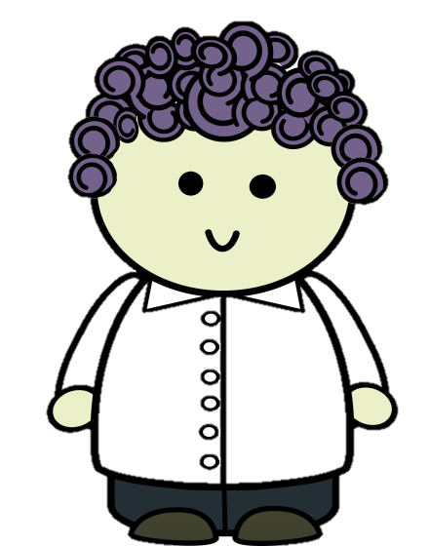
Eddie has invited two friends over to play marbles with her/him -- Jessie and Chris. Eddie wonders who will get to her/his house first -- Jessie lives next to Eddie’s house on this side, and Chris lives next to Eddie’s house on that side. [pointing] So -- where does Jessie live? And Where does Chris live?
Notes:
Eddie has invited two friends over to play marbles with her -- Dale and Chris. Eddie wonders who will get to her/his house first -- Dale lives next to Eddie’s house on this side, and Chris lives next to Eddie’s house on that side. [pointing] So -- where does Dale live? And Where does Chris live?

Slide 2
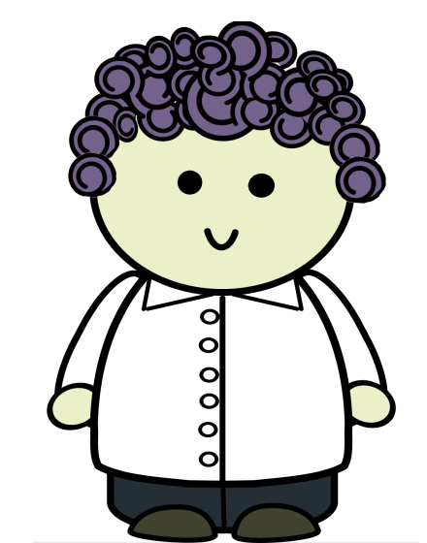





Eddie gets ready for her/his friends visit by putting her/his marble underneath the lid of the basket [sister in room observing in pic].
Notes:
Eddie gets ready for her/his friends visit by putting her/his marble underneath the lid of the basket [sister in room observing in pic].

Slide 3
So where did Eddie leave the marble?
Notes:
So where did Eddie leave the marble?

Slide 4
Eddie goes in the kitchen to get cookies ready for her/his friends. But, look! While Eddie is away, her/his sister moves the marble from the basket to the box. Did you see that? See how she moved the marble while Eddie is away.
Notes:
Eddie goes in the kitchen to get cookies ready for her friends. But, look! While Eddie is away, her/his sister moves the marble from the basket to the box. Did you see that? See how she moved the marble while Eddie is away.

Slide 5
So where is the marble now?
Notes:
So where did Eddie leave the marble? And to where is it now?

Slide 6

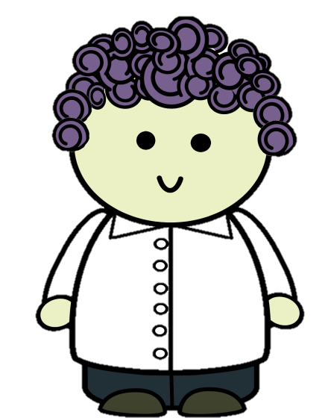
Okay, now Eddie is coming back to the room. S/he is about to go get her/his marble so it‘s ready to play with and also hears a friend coming up the steps to her/his door.
Here’s where we get to have your help with the story! You can find out where Eddie goes to get her/his marble first -- does she walk to the box or walk to the basket. Or, instead, you can find out who’s coming up the steps -- is it Jessie or is it Chris. If you want to find out where Eddie goes for the marble please click this; if you want to find out which friend is coming please click that.
Notes:
Okay, now Eddie is coming back to the room. S/he is about to go get her/his marbles so they are ready to play with and also hears a friend coming up the steps to her/his door.
[to child] Here’s where we get to have your help with the story! You can find out where Eddie goes to get her/his marbles first -- does she walk to the box or walk to the basket, please click this. Or, instead, you can find out who’s coming up the steps -- is it Dale or is it Chris. If you want to find out where Eddie goes for the marbles please click this; if you want to find out which friend is coming please click that.”

Slide 7
Eddie goes to the basket to look for her marble.
Notes:
Eddie goes to the basket to look for her marble.

Slide 8
The end
Eddie’s sister told her where the marble was and both of Eddie’s friends made it to the house! Eddie’s sister apologized for hiding the marble and they all had lots of fun playing together.
Notes:
Eddie’s sister told her where the marble was and both of Eddie’s friends made it to the house! Eddie’s sister apologized for hiding the marble and they all had lots of fun playing together.

Slide 9

It’s Chris coming first!
Notes:
It’s Chris coming first!

